Slide 1
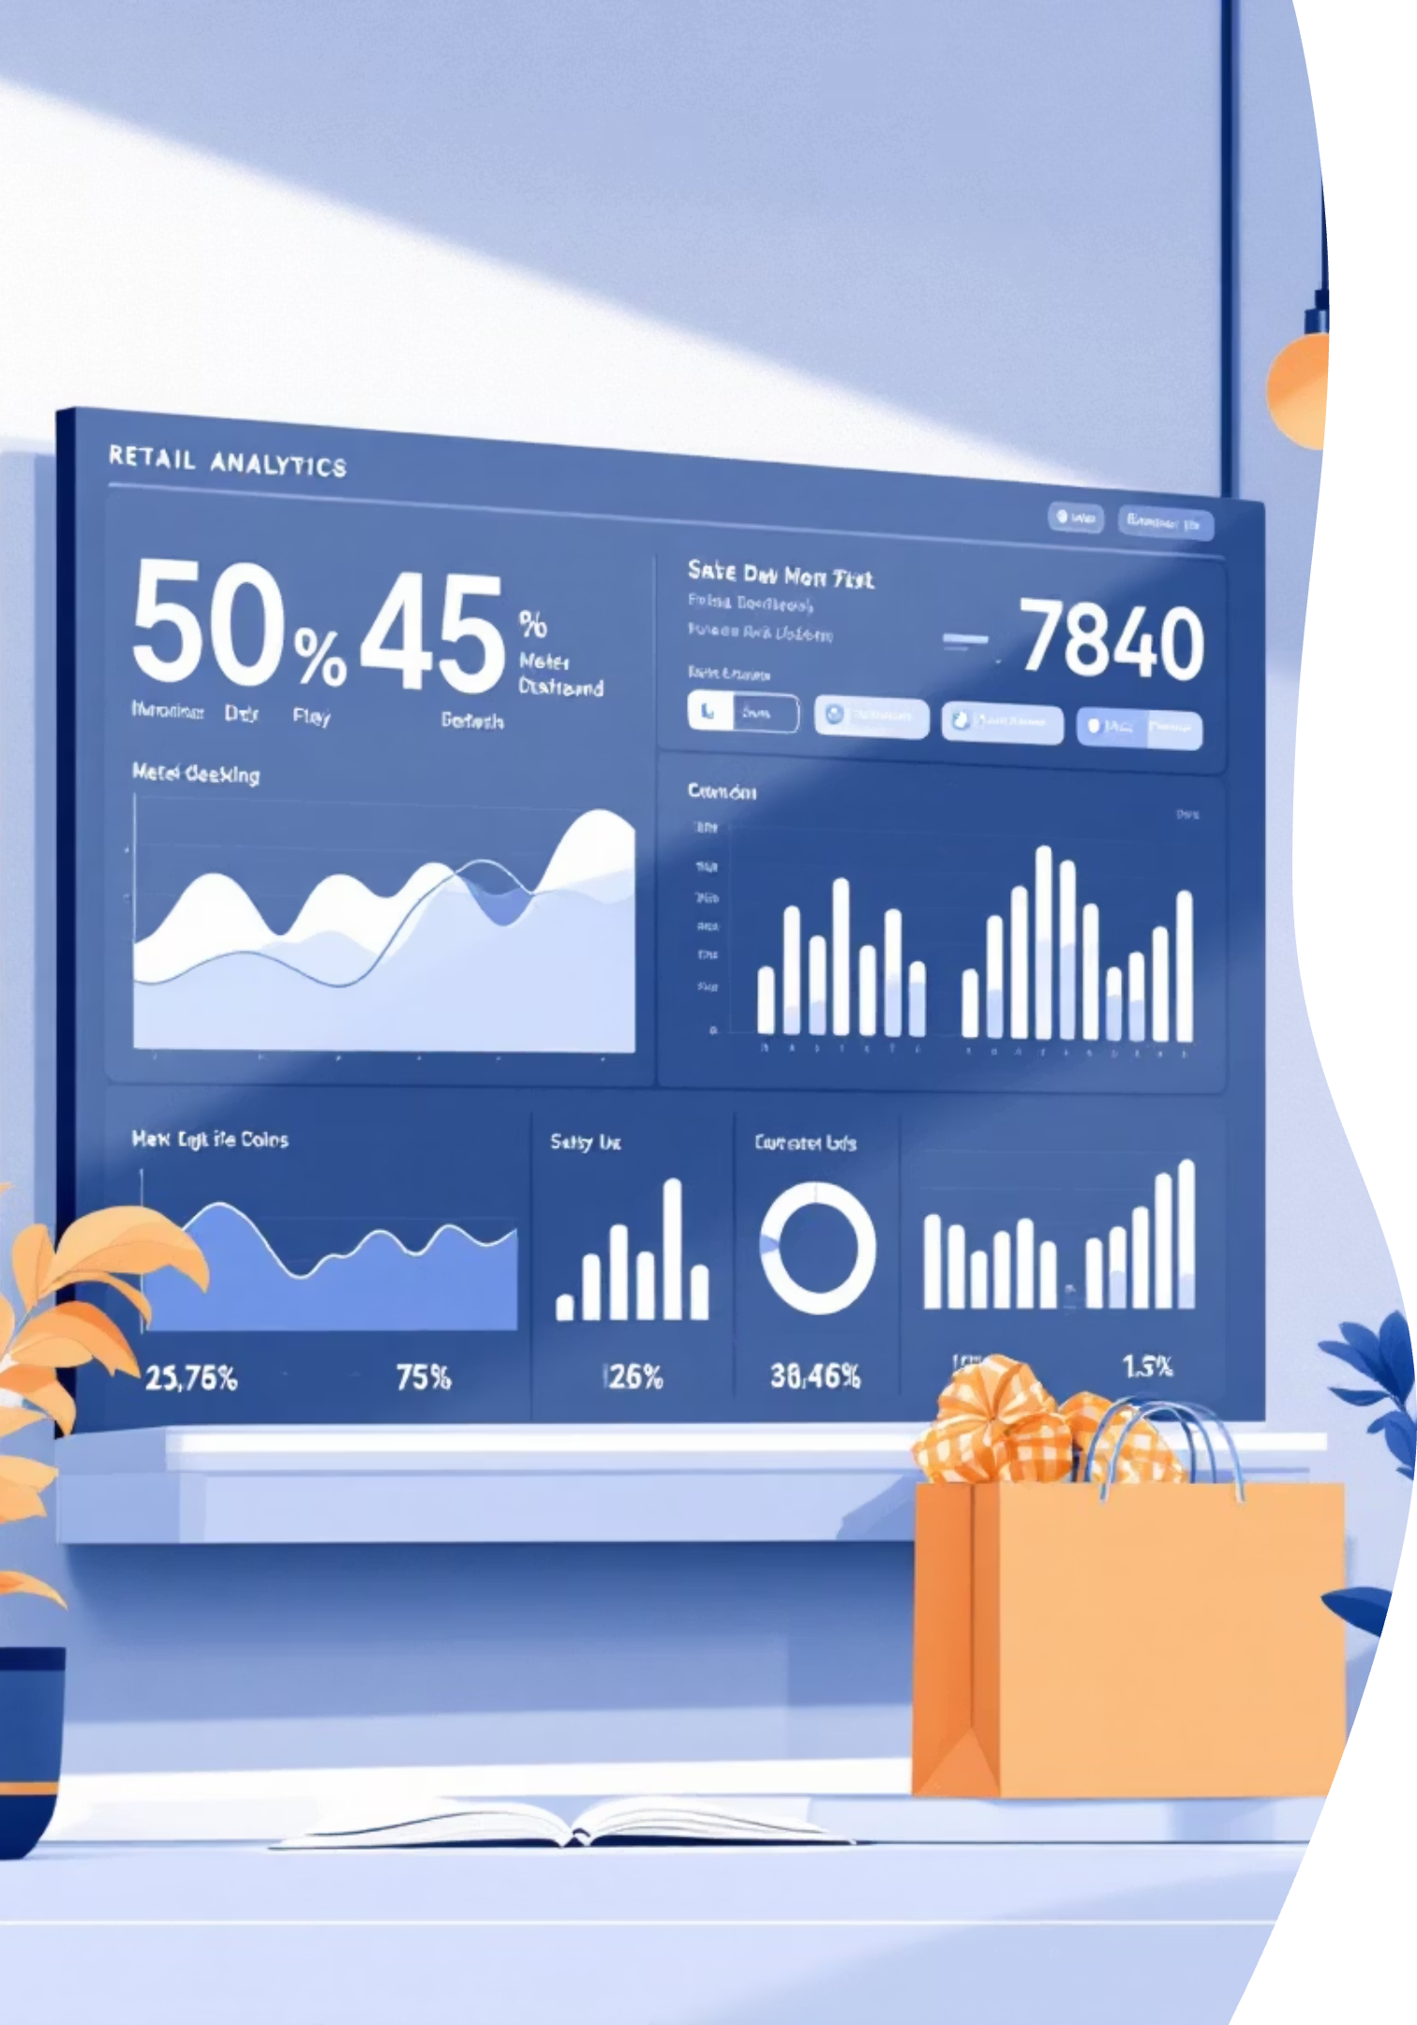
Customer Shopping Behavior Analysis
Analyzing 3,900 purchases to uncover insights into spending patterns, customer segments, and product preferences that drive strategic business decisions.

Slide 2
Dataset Overview
3,900
18
37
Total Purchases
Data Features
Missing Values
Transactions analyzed across all categories
Comprehensive customer and purchase attributes
Only in Review Rating column
Customer Demographics
Purchase Details
Age, Gender, Location
Item, Category, Amount
Subscription Status
Season, Size, Color
Purchase History
Discounts & Promotions

Slide 3

Data Preparation & Cleaning
01
02
Data Loading
Missing Data Handling
Imported dataset using pandas and explored structure with df.info() and .describe()
Imputed Review Rating nulls using median rating per product category
03
04
Feature Engineering
Database Integration
Created age_group and purchase_frequency_days columns for deeper analysis
Connected to PostgreSQL and loaded cleaned data for SQL analysis

Slide 4
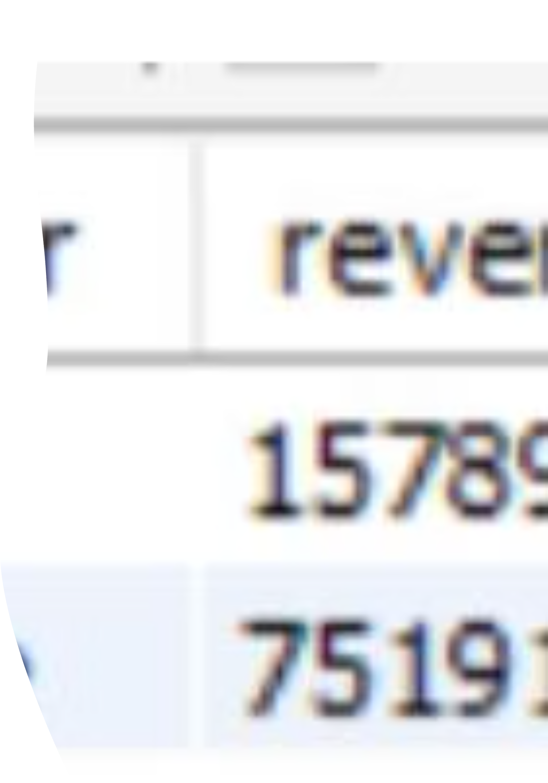

Revenue Analysis by Gender
Male customers generated significantly higher total revenue compared to female customers, representing a key demographic for targeted marketing strategies.
Key Insight: Gender-based purchasing patterns reveal opportunities for personalized product recommendations and campaigns.

Slide 5
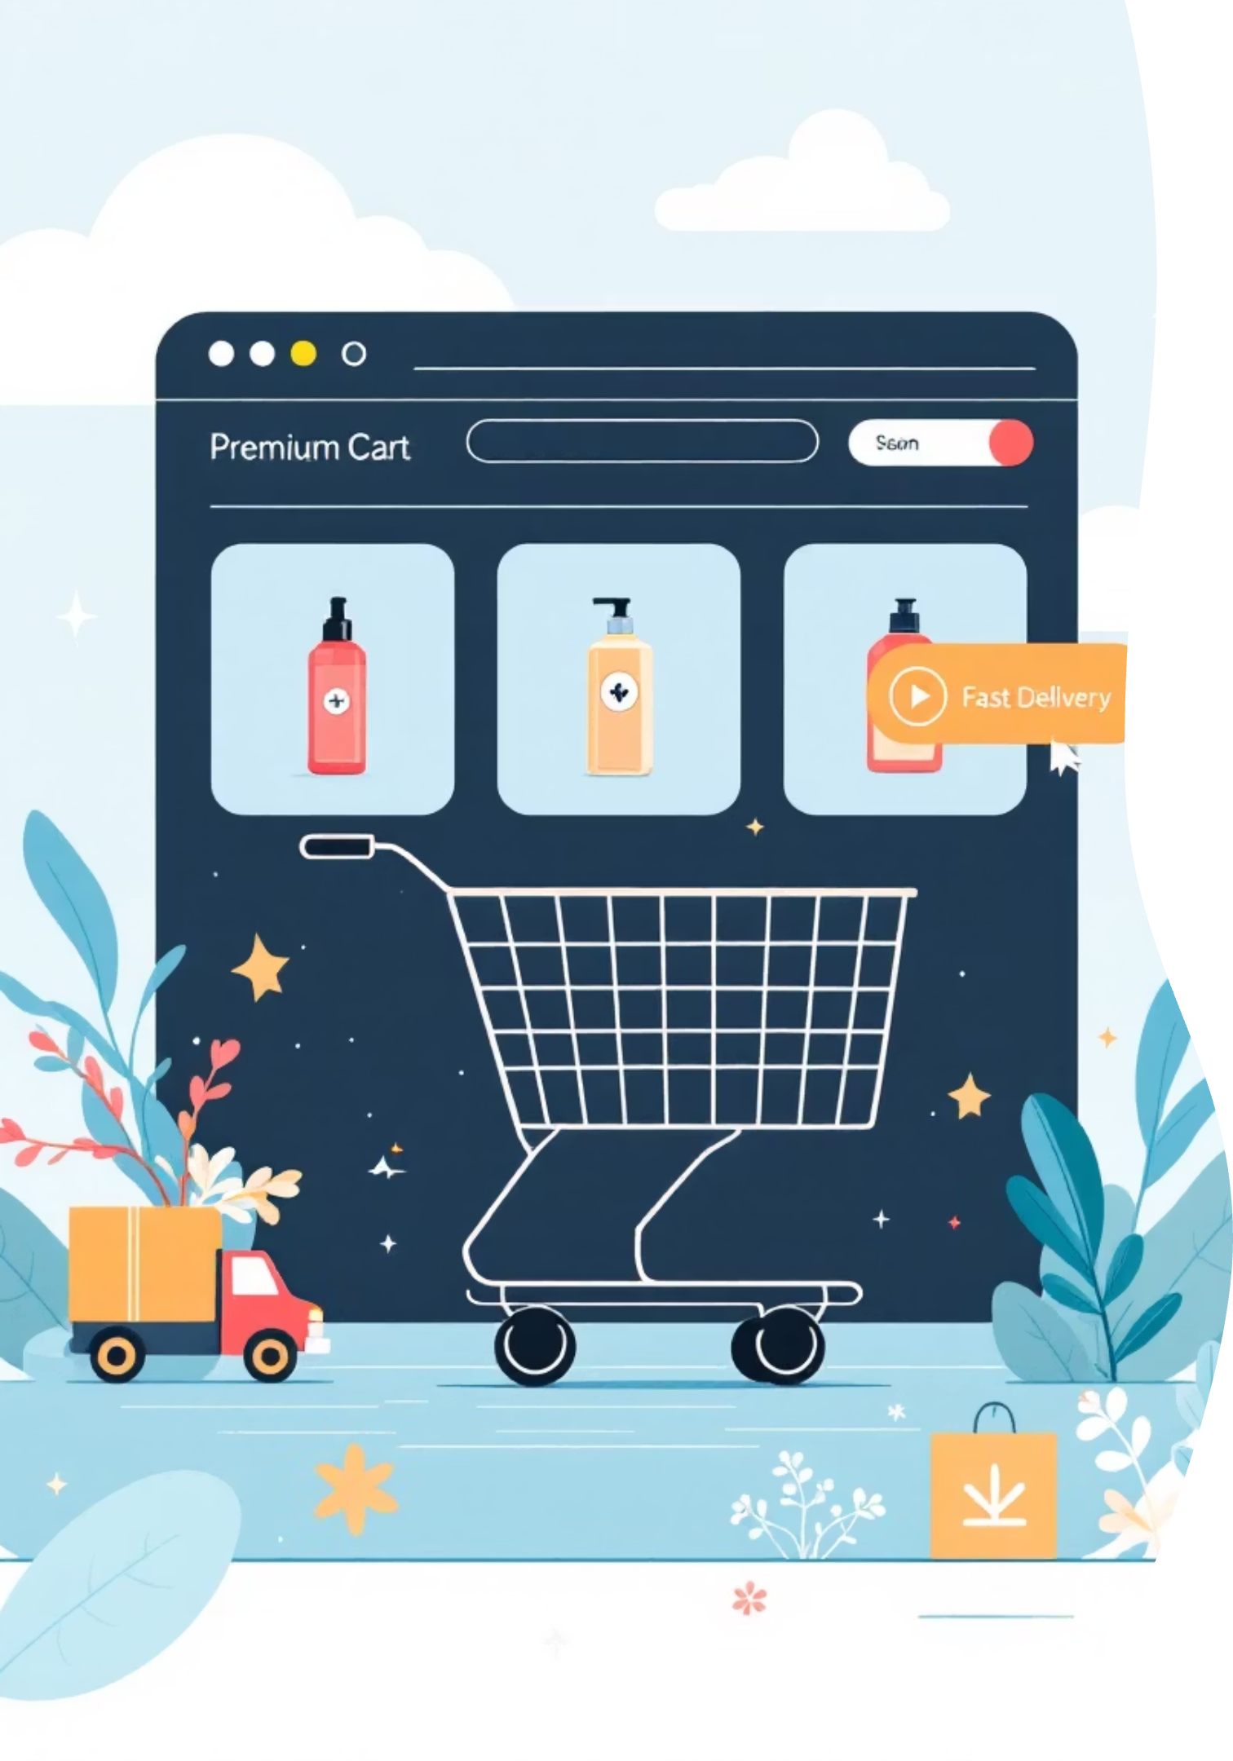
Customer Spending Insights
High-Spending Discount Users
Top-Rated Products
Gloves (3.86), Sandals (3.84), and Boots (3.82) lead in customer satisfaction ratings.
Identified customers using discounts who still spent above average—showing price sensitivity doesn't always mean lower value.
Shipping Preferences
Express shipping users spend $60.48 on average vs. $58.46 for Standard—indicating willingness to pay more.

Slide 6
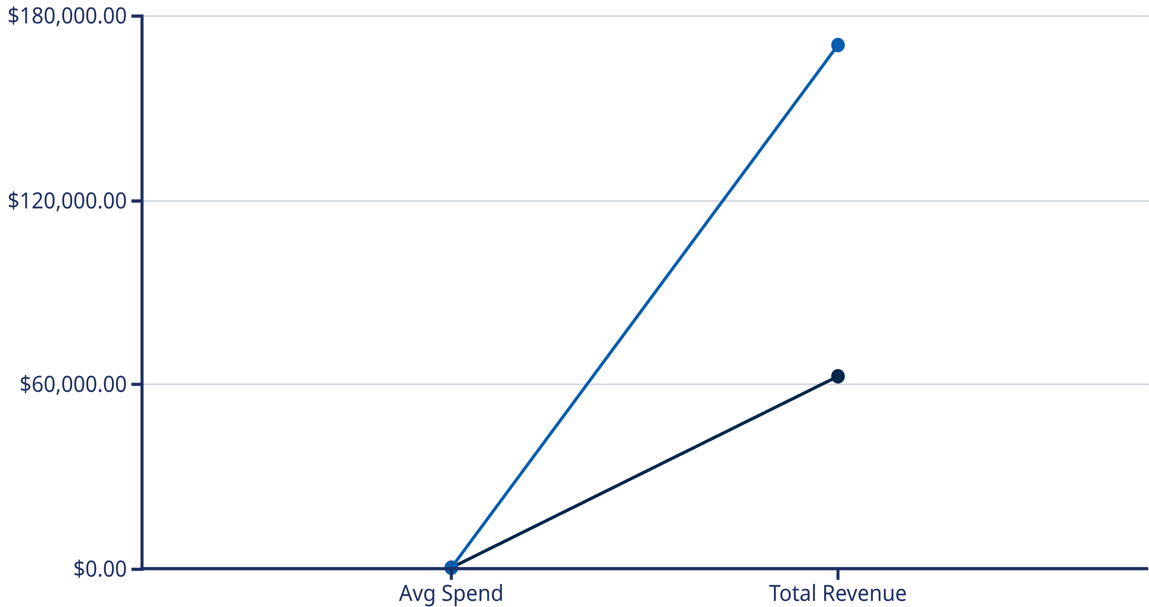
Subscription Status Comparison
Subscribers
Non-Subscribers
Subscribers: 1,053 customers
Non-Subscribers: 2,847 customers
Similar average spend but lower total revenue due to smaller customer base.
Massive opportunity to convert this segment and boost recurring revenue.

Slide 7



Customer Segmentation
1
New (83)
2
Returning (701)
3
Loyal (3,116)
The majority of customers (80%) are classified as Loyal based on purchase history, demonstrating strong customer retention. Focus on moving Returning customers into the Loyal segment through targeted engagement.

Slide 8

Product Performance Analysis
1
2
Accessories
Clothing
Top 3: Jewelry (171), Sunglasses (161), Belt (161)
Top 3: Blouse (171), Pants (171), Shirt (169)
3
4
Footwear
Outerwear
Top 3: Sandals (160), Shoes (150), Sneakers (145)
Top 3: Jacket (163), Coat (161)
Discount Dependency: Hat (50%), Sneakers (49.66%), and Coat (49.07%) show highest discount rates—consider pricing strategy adjustments.

Slide 9
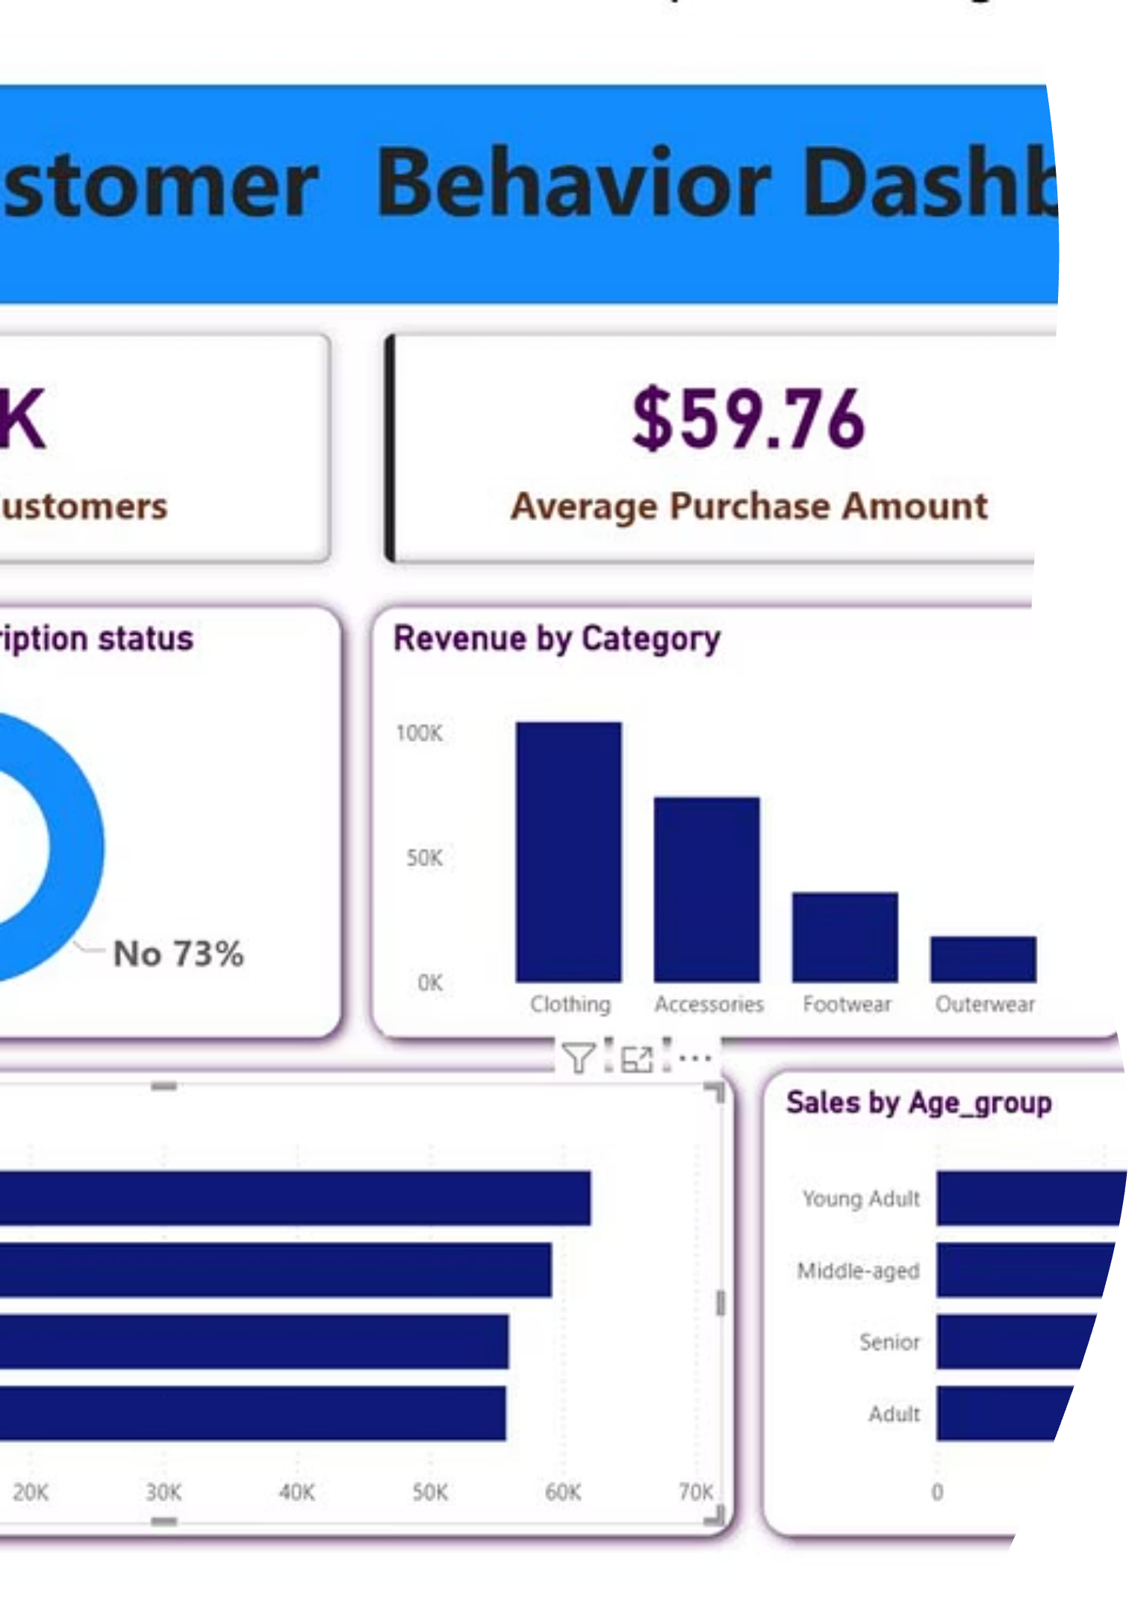
Interactive Dashboard
Power BI dashboard provides real-time visualization of key metrics including revenue trends, customer segments, product performance, and demographic insights for data-driven decision making.

Slide 10

Strategic Recommendations
Boost Subscriptions
Loyalty Programs
Review Discount Policy
Promote exclusive benefits to convert 2,847 non-subscribers and increase recurring revenue.
Reward repeat buyers to accelerate movement from Returning to Loyal segment.
Balance promotional sales with margin control, especially for high-discount products.
Product Positioning
Targeted Marketing
Highlight top-rated items (Gloves, Sandals, Boots) in marketing campaigns.
Focus on high-revenue age groups and express-shipping users for maximum ROI.

